Slide 1
WEBINAR: Integrated Care in Hawke’s Bay
International Conference on Integrated Care 2025

Slide 2
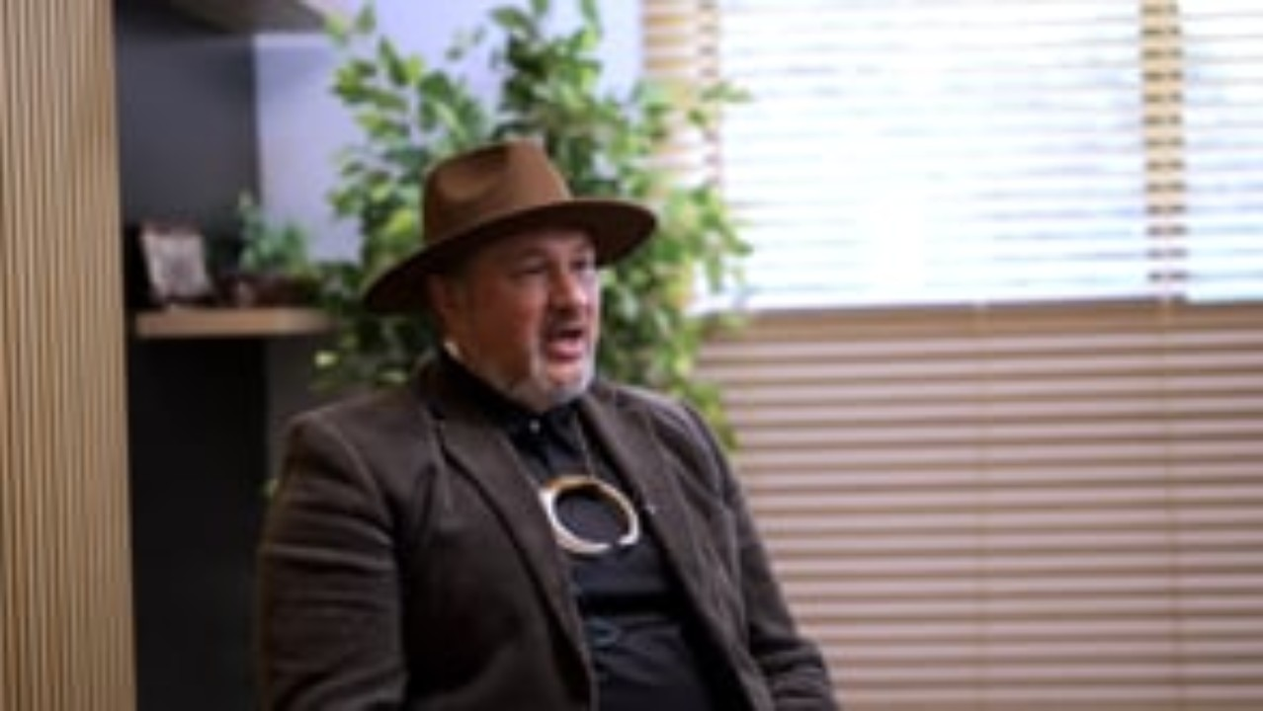

Slide 3
Purpose and theme
Theme of the conference:
Synergising Health and Care: Leveraging Integrated Care for a Sustainable Future
The 25th International Conference on Integrated Care (ICIC25) took place in Lisbon, Portugal on 14-16 May 2025.
There were:
Approximately 1,000 attendees
Approximately 455 oral presenters
Representation from around 50 countries

Slide 4


Indigenous-led Uniquely Aotearoa
Intergrated Care Requires Indigenous Leadership
Equity-Focused Data Systems Are Critical
Co-Design Service Delivery Creates Stronger Engagement
Works Sustainability Through Community Investment
Digital Enablement Without Cultural Dilution
Opportunities
Global Recognition of Māori -Led Primary Care
Partnerships for Research & Evaluation
Advance Whānau Voice as a Global Model
Notes:
KEY FINDINGS
Integrated Care Requires Indigenous Leadership
Many international models lacked Indigenous governance, cultural frameworks, and authentic voice.
Health systems that integrated Indigenous health philosophies (like Te Ao Māori) achieved better community trust and health equity outcomes.
Equity-Focused Data Systems Are Critical
The most successful models used real-time, whānau-centred data dashboards.
These systems tracked patient journeys across primary, secondary, and social sectors, informing responsive care.
There was a strong focus on equity-based data segmentation—an opportunity for Te Puna Taiao.
Co-Designed Service Delivery Yields Stronger Engagement
Case studies demonstrated that co-design with communities, especially marginalised groups, improved access, service satisfaction, and continuity of care.
This validated HHB’s ongoing kaupapa like Whānau Voice Engagement and Kāhui-led models.
Workforce Sustainability Through Community Investment
Innovative internship models in Canada and Scandinavia mirrored ‘E Hao, E Pao’—affirming its relevance.
Some systems embedded cultural and community navigators as paid roles in clinical teams, not just advisory.
Digital Enablement Without Cultural Dilution
AI and digital triage were widely used—but concerns were raised about cultural safety and data sovereignty.
Strong governance models included Indigenous data sovereignty agreements and whānau-centred consent processes.
OPPORTUNITIES
Elevate Te Puna Taiao as a Leading Platform
Position Te Puna Taiao as an equity intelligence ecosystem, aligning with global standards while embedding Māori data narratives.
Create pathways for sharing this model globally, beginning with Aotearoa and Te Whatu Ora.
Global Recognition of Māori-Led Primary Care
HHB could present E Hao, E Pao and Te Kāhui Amokura models internationally as case studies in Indigenous-led workforce and governance.
Pursue publication or presentation at the next International Conference.
Partnerships for Research & Evaluation
Collaborate with EU and Canadian Indigenous organisations to benchmark Māori health outcomes using shared Indigenous health indicators.
Explore joint research initiatives around integrated care and sovereignty.
Advance Whānau Voice as a Global Model
Formalise HHB’s Whānau Voice Engagement Strategy as a model for relational accountability in healthcare.
Could become a blueprint for participatory health design across the Southern Hemisphere.
Host an Aotearoa-based Indigenous Primary Care Summit
Leverage Portugal learnings and international networks to host a 2026 summit led by Māori health leaders, showcasing the HHB ecosystem (e.g. Kahui, Whānau Voice, Rongoā Māori, data intelligence).
NEXT STEPS
Engage with National & Regional Stakeholders
Share Findings with
Local Provider Network
Te Whatu Ora
Māori PHO and Iwi Māori Partnership Boards
Strengthen and Accelerate Māori Led Workstreams
Focus on initiatives that directly reflect International best practice
Te Puna Taiao
E Hao, E Pao
Whānau Voice Engagement Strategy
Te Kāhuia Amokura & Kāhui Ecosystem
Develop an International Publication or Conference Abstract
Submit findings and the HHB response to:
International Journal of Integrated Care
Māori Health Review or Journal of Indigenous Wellbeing
2026 ICIC Conference or Indigenous Health Summits
Could be co-authored by all those in attendance and I
Conference Trends & Literature Reflected at ICIC (Portugal, 2025)
1. Portugal ICIC 2025 Presentation Streams
Several sessions at the ICIC have consistently featured workforce pipeline models that:
Recruit local or Indigenous youth into health pathways.
Embed paid roles such as "community health navigators" or "cultural brokers" into the workforce.
Use co-designed internships rooted in local community values.
2. Canada (First Nations, Inuit, Métis Health Models)
Referenced in past ICICs and published work through:
Canadian Indigenous Health Alliance programmes.
Paid internships for Indigenous students in primary care through First Nations Health Authority (BC) and Indigenous Services Canada.
A focus on “grow-your-own” models, similar to E Hao, E Pao, ensuring local, culturally grounded staff are embedded in health systems long term.
3. Scandinavia (Particularly Norway, Finland, Sweden – Sámi Health Services)
Internship models include:
Local youth placements in Sámi primary health centers.
Integration of traditional knowledge holders into formal healthcare settings.
Strong state support to fund dual-language, culturally safe placements in underserved regions.
Mentioned in ICIC research papers and parallel sessions under themes like "Integrated workforce resilience” and “Health Equity in Remote Indigenous Communities.”
4. OECD Health Workforce Resilience Report (2023–2024)
Cited best practice case studies from these countries in workforce retention through community-based entry pipelines, including school-to-health-career bridges.

Slide 5
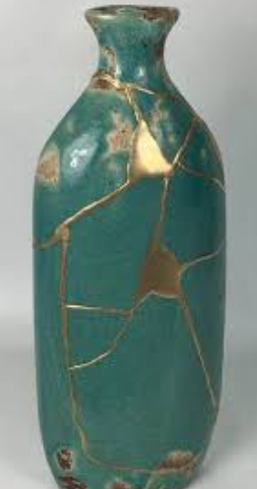
The value of our people
Building social capital = Human capital as a valued embedded resource across communities
Many of the presentations focused on the value of investing in the workforce to allow integrated care to flourish.
The Kintsugi Program, from Norfolk in the UK was developed for this reason:
Kingtsugi is the Japanese art of putting broken pots back together into something beautiful.
They developed a fellowship program to invest in their local people. This works to build capacity, capability and confidence which embedded research with the local community and no “to” the community.
Successful programs could then flourish, with robust data to support them.

Slide 6
Peer Health Navigators – integration beyond the hospital
A combination of two presentations: one from Australia and one from Canada really reframed the role of peer health navigators.
There is extensive international guidance from the WHO and similar health systems around the world on ways to implement these roles successfully.
By transforming their use from hospitals into the community we can build on the value of expert patients to codesign and implement the additional help for the right groups in our community.
Currently a lack of recognition of skills rather than qualifications, and absence of formalized training is a barrier which we could overcome.

Slide 7
Improving Primary/Secondary Care Interface…
Benefits of Hawkes’ Bay being a medium sized centre
○ Access to clinical portal, shared notes
○ Ability to order a range of tests
○ Established relationships between Secondary Care, Primary Care, PHO
+ Community Providers
Ireland: “Leveraging Technology for Alternative Referral
Pathways and Access to Consultant Cardiologists”
○ Regular protected sessions for GPs to access local cardiologists
○ Relieves pressure on GPs due to improved access to specialist support +
guidance on management + higher quality/more appropriate referrals
= improved patient care

Slide 8
Priority Populations….
Complex unenrolled population Rangatahi
South Central Foundation - NUKA Model of Care
● Building on models already explored by other Primary Care
teams in Hawkes Bay
● NUKA Playbook, ICIC Pillars
● Culture front and centre
● Built on ICTs – right people, right skill set, right care, working at
top of scope
● Empowering communities to take control of their health
journey
● Data driven, achieving better outcomes

Slide 9

Codesigned Rangatahi Health Services
All services must be codesigned with the users who will use them.
Integration of Digital Tools into health services are seeing innovations and advancements
Opportunities
Utalise Integrated Care Principles to establish a responsive, innovative and responsive health service for our rangatahi.
Next steps
Bring our Rangatahi together to codesign their Health Services with Health NZ
Ensure the Integrated Care approach is taken to this work to embed a long-term service that our Hawke’s Bay Rangatahi need.

Slide 10

Next Steps…
Together we need to establish a Hawke’s Bay Integrated Care leadership group.
We will call for interested people from across the network and get some kaupapa going

